Slide 1
Run your PACMAN

Slide 2


Slide 3


Slide 4
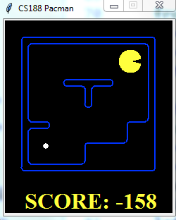
How to Represent the PACMAN to computer

Slide 5
?

Slide 6
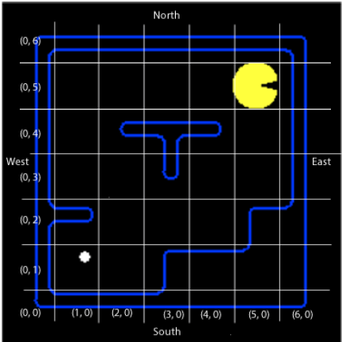

Computation Model

Slide 7
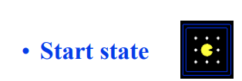
https://courses.cs.washington.edu/courses/cse473/13au/slides/03-search.pdf

Slide 8
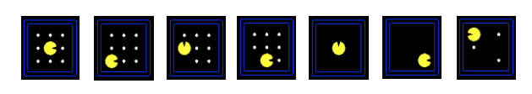
State space

Slide 9
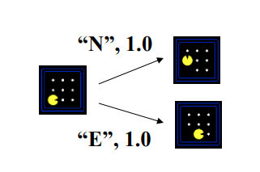
Successor function

Slide 10
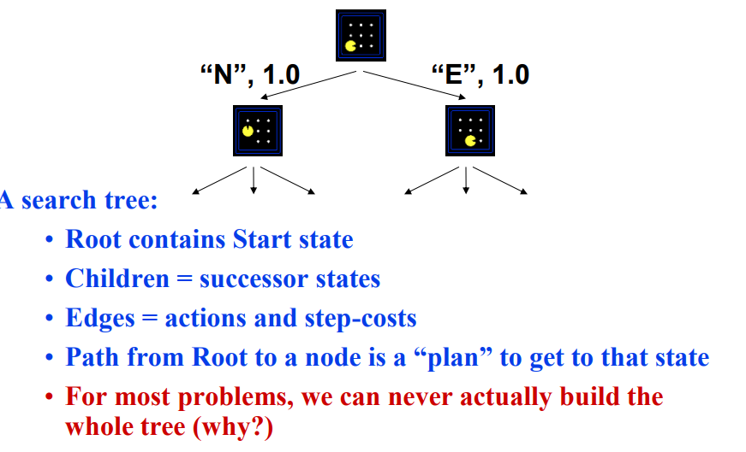

Slide 11
startState=problem.getStartState()
(4,3)
Problem.getSuccessor(startState)
[((3,3),w,cost),((4,2),s,1)]

Slide 12
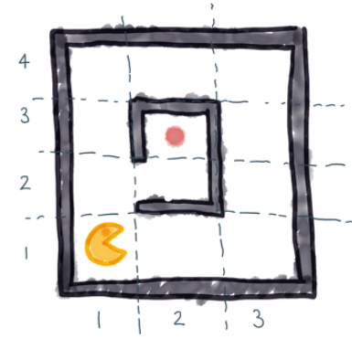

Slide 13
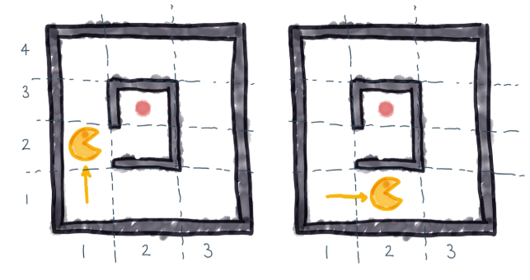

Slide 14
